Slide 1

SHOWER POWER
By Shruti, Lauren, Leila and Veronica

Slide 2
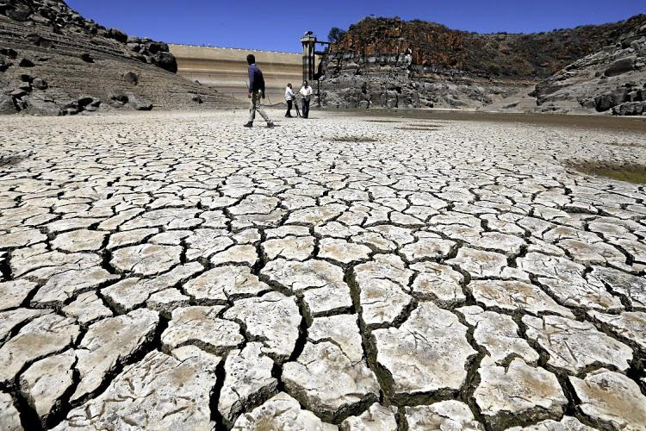
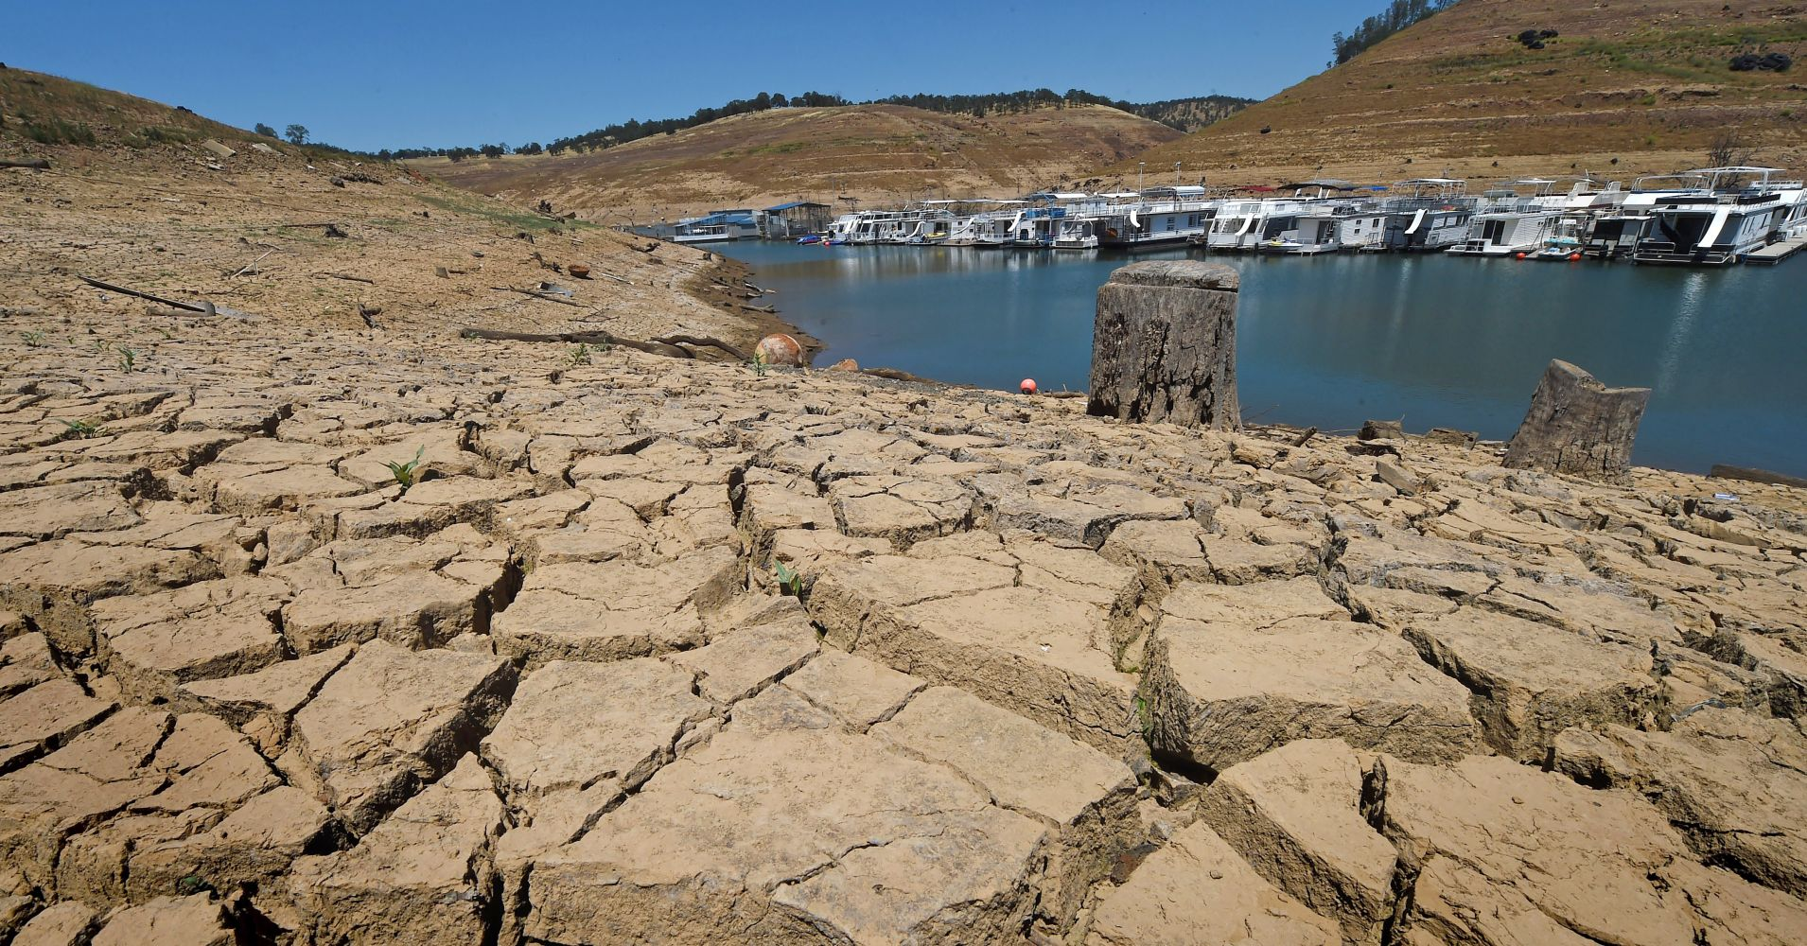
WATER SCARCITY IS A GLOBAL PROBLEM
Drought in Cape Town, Africa
Drought in California
Notes:
By summer, four million people in the city of Cape Town—one of Africa's most affluent metropolises—may have to stand in line surrounded by armed guards to collect rations of the region's most precious commodity: drinking water.

Slide 3
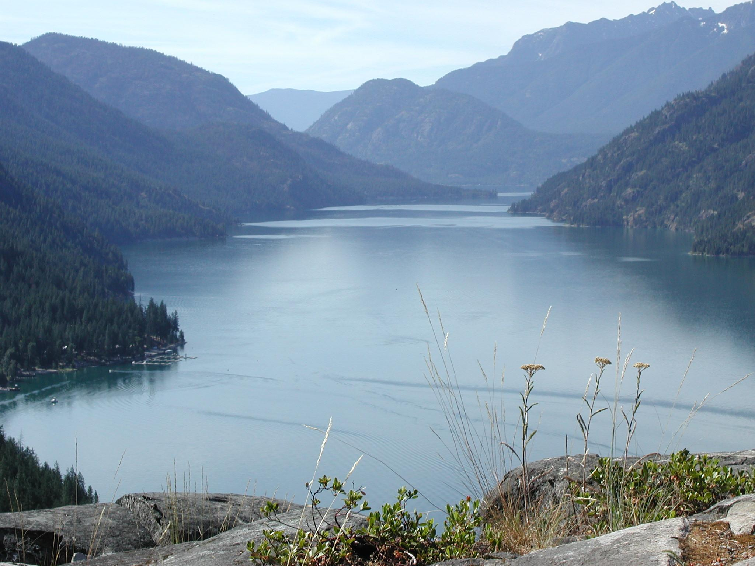
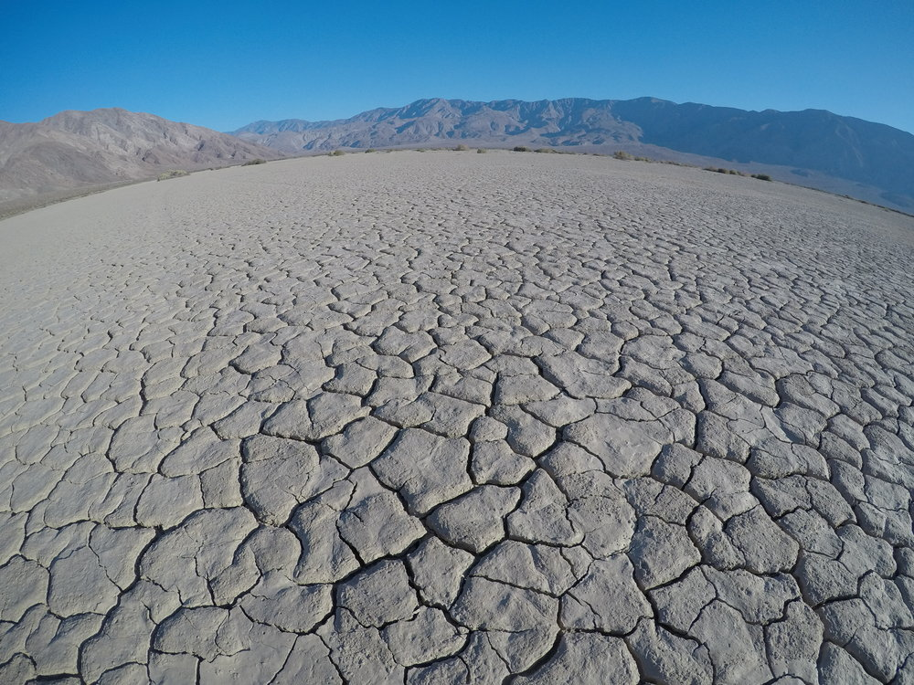
Imagine Lake Chelan

Slide 4
Competitive Analysis
No other existing application in the market
Only shower games on the App store
Web apps - not shower friendly

Slide 5
Why Shorter Showers?
The average American uses 25,300 gallons of water a year (69.3 gallons daily).
An average shower uses about 5 gallons of water per minute.
If you shorten your shower by 2 minutes, you can cut your water use by 10 gallons.
Notes:
A small difference can make a big change.

Slide 6
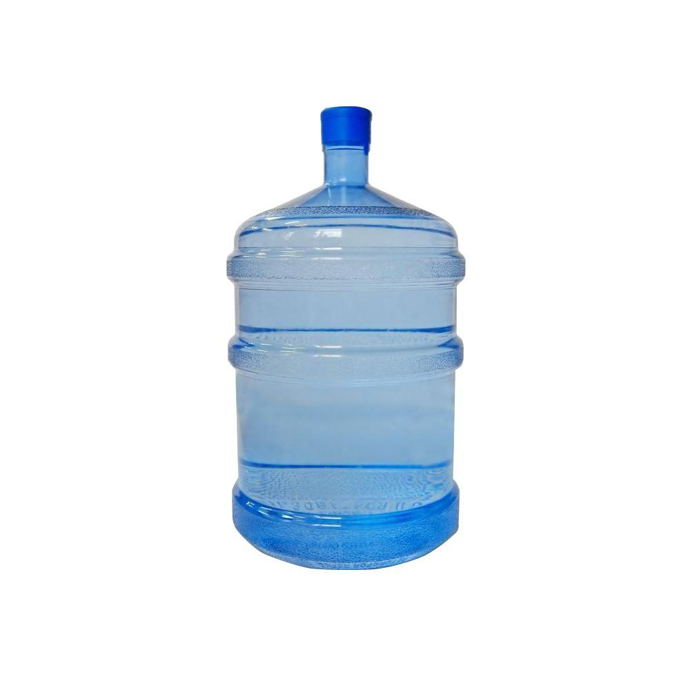
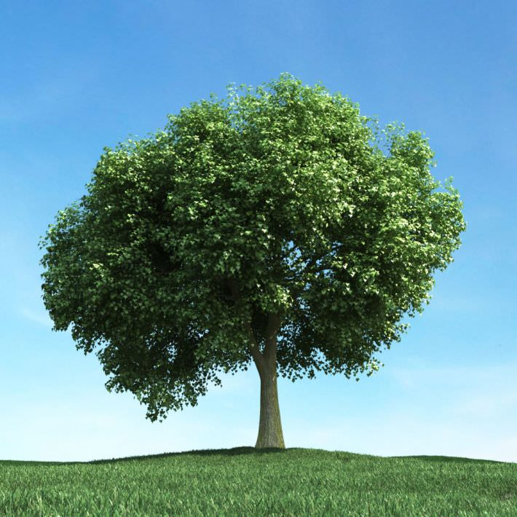
5 Gallons per minute
A tree needs 20 gallons of water a week!
If we save 4 minutes of our shower time, we can water a tree for a week!

Slide 7
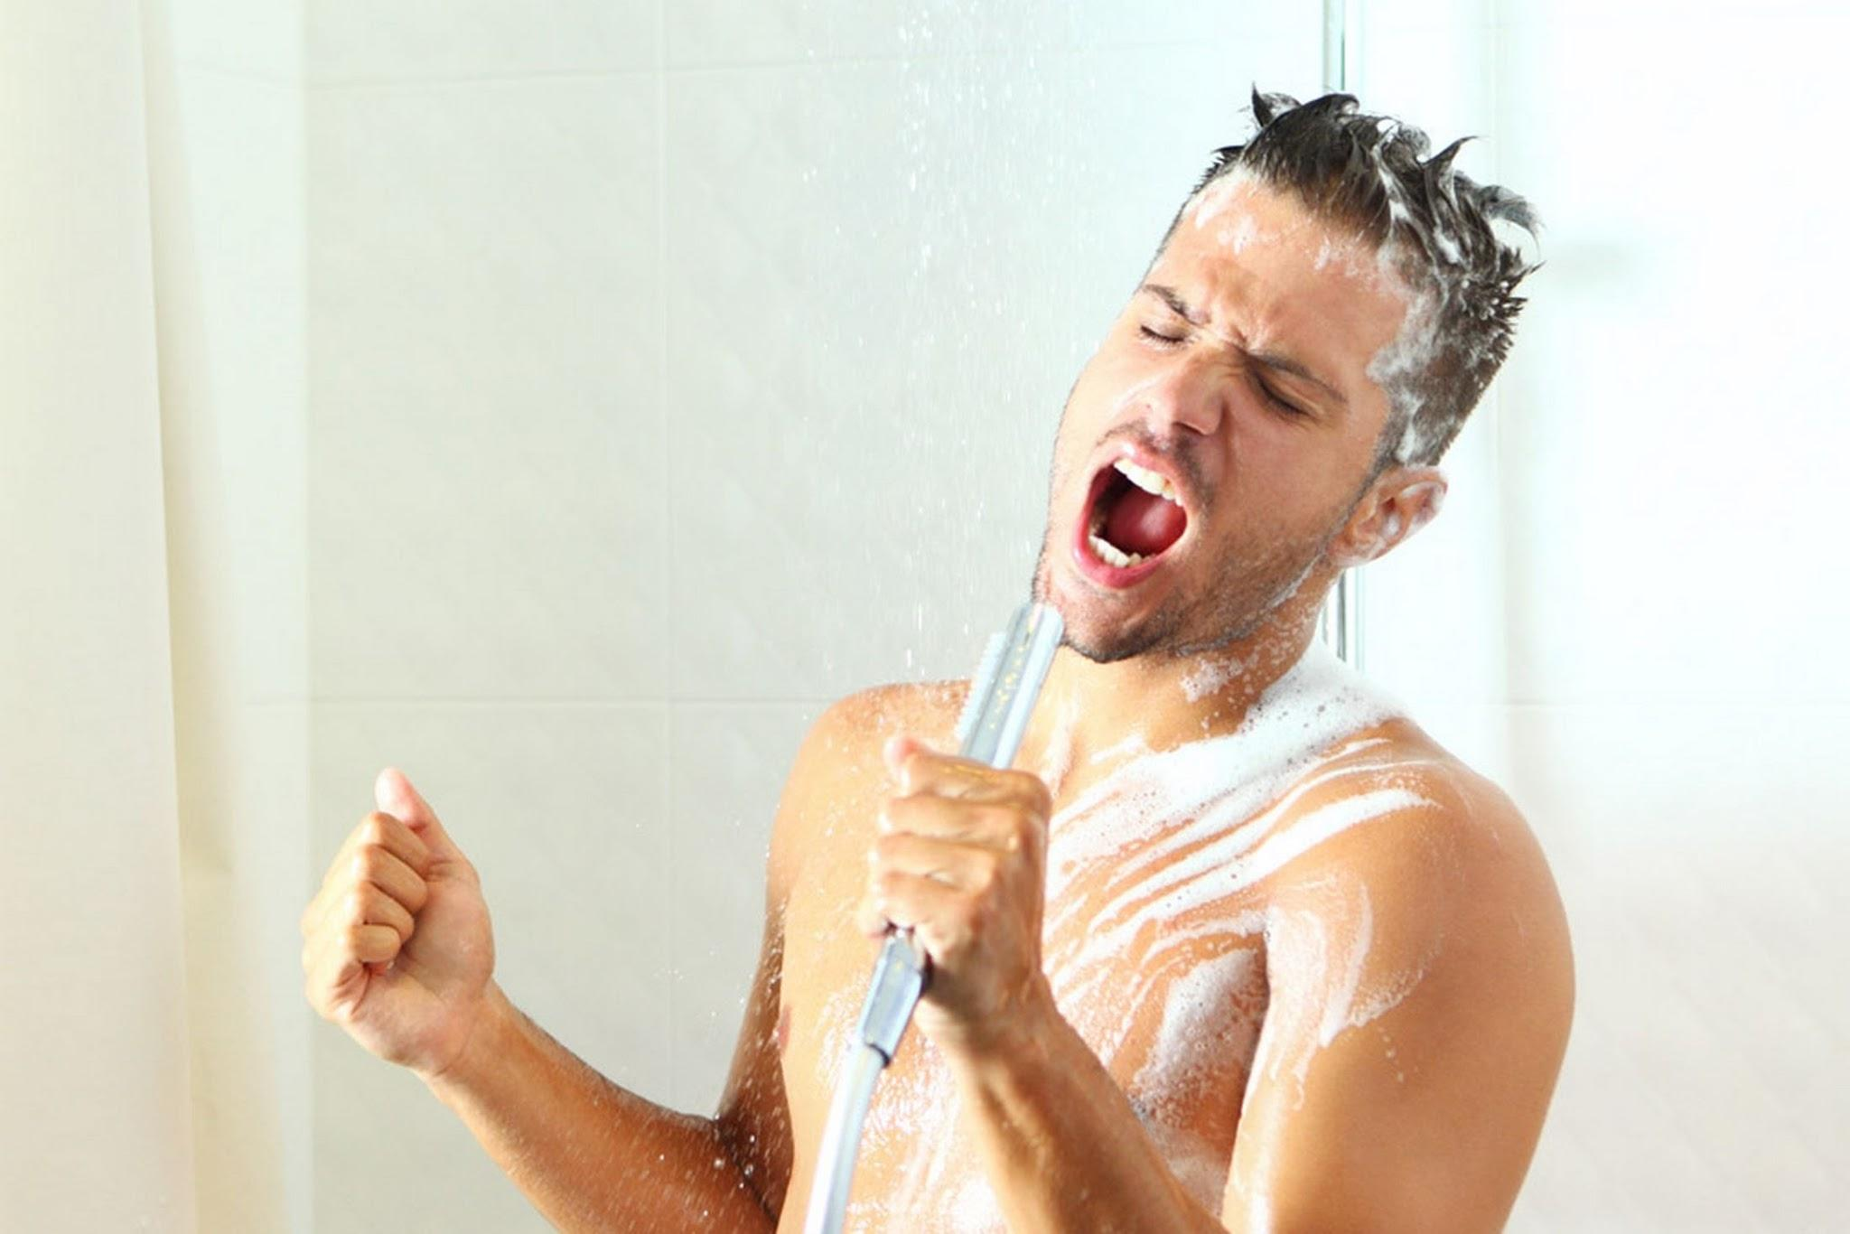
Singing
Integrate our favorite activity - singing!
To make showers more sustainable and still enjoyable!

Slide 8
BATHTUB ANIMATION
Give visual feedback of how length of the shower in relation to the set time

Slide 10
LIVE DEMO
A fully functional app coded using Swift

Slide 11
The App
Took over 500 lines of code
Has a timer to keep track of how long the shower is
Infinite scrolling for song selection
Notification to let you know you are over the time limit
After the time limit the number becomes red

Slide 12
Accessibility Consideration
Used this to make sure this application was accessible to people with visual impairment. (Used Web Accessibility in Mind : https://webaim.org/)
Hearing impairment: We gave both a visual and audio feedback (bathtub animation/timer + sound effects)
Lock screen - swipe action

Slide 13

Color Palette
Took into consideration our theme/idea.
We went with blue to represent water
Made sure the contrast and color was accessible

Slide 14
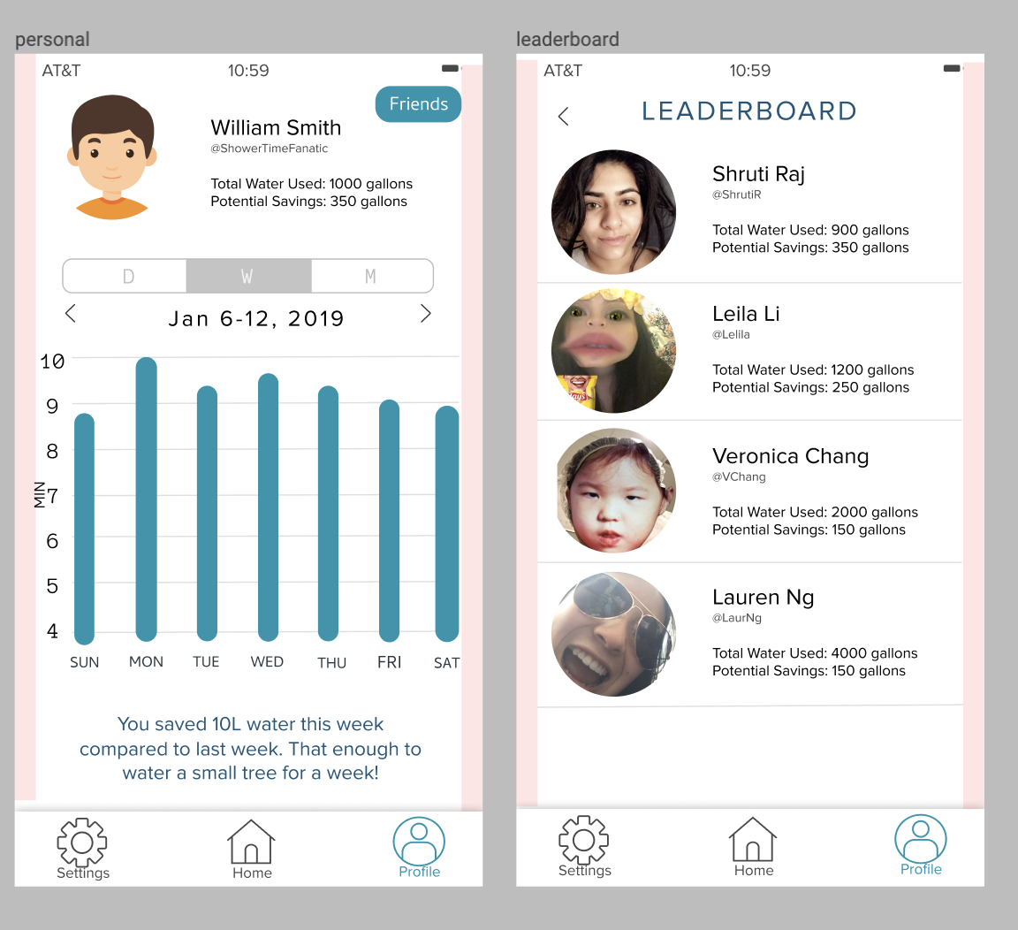
Pixel Perfection:
Font
Padding
Icons
User flows
Accessibility

Slide 15
CREDITS
Special thanks to all the people who helped us with this project:
Anna from Avanade
Edgar from Ticketmaster

Slide 16
THANKS!
Any questions?

